Slide 1






Foundations of
Quantum Information Science (QIS 101)
Dave Biersach
Brookhaven National Laboratory
dbiersach@bnl.gov
Session 15
Vector Algebra

Slide 2
Session 15 – Goals
Understand 3D axes in matplotlib
Plot Archimedes' Spiral in 3D using cylindrical coordinates
Understand 3D vertices and facets in matplotlib
Plot a 3D wireframe monolith using Cartesian coordinates
Plot a 3D pyramid that conforms with the Golden Ratio
Relate poloidal and toroidal angles in spherical coordinates
Use Numpy to generate the outer product of two vectors
Plot a 3D sphere using only vertices (a scatter plot)
Plot a 3D wireframe and facets of a sphere and torus
Plot the 3D surface plot of a multivariable function

Slide 3
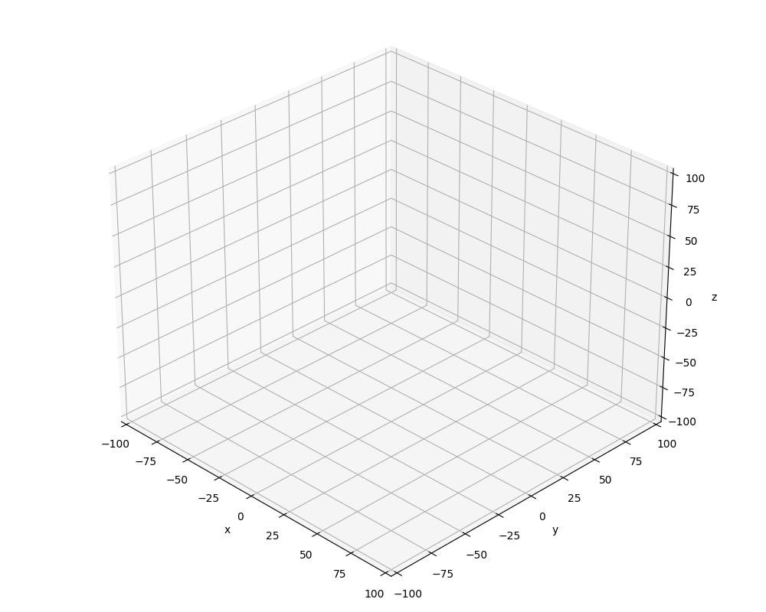
3D Cartesian Coordinates in matplotlib
$$y^{+}$$
$$x^{+}$$
$$z^{+}$$
$$z^{+}$$
$$y^{+}$$
$$x^{+}$$

Slide 4
3D Cartesian Coordinates in matplotlib
$$y^{+}$$
$$x^{+}$$
$$z^{+}$$
$$z^{+}$$
$$y^{+}$$
$$x^{+}$$

Slide 5
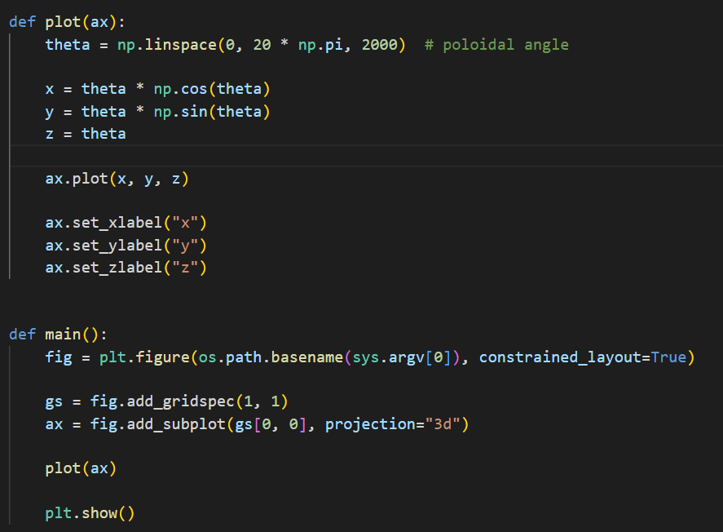
Open plot3d_helix.py
①
②
③
④
⑤

Slide 6
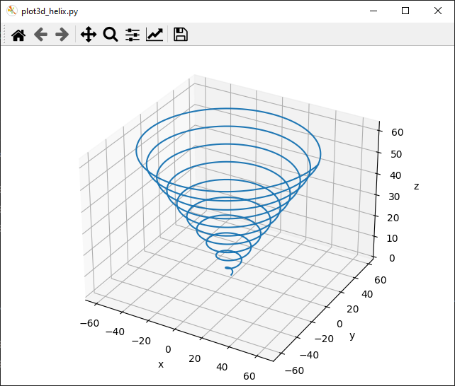
Run plot3d_helix.py
Left click and drag to rotate the plot

Slide 7
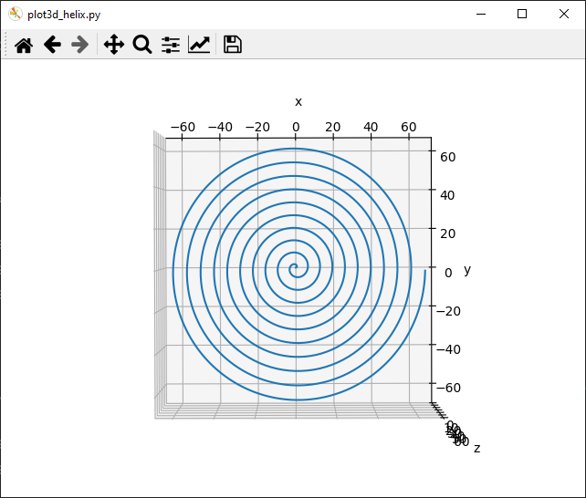
Run plot3d_helix.py

Slide 8
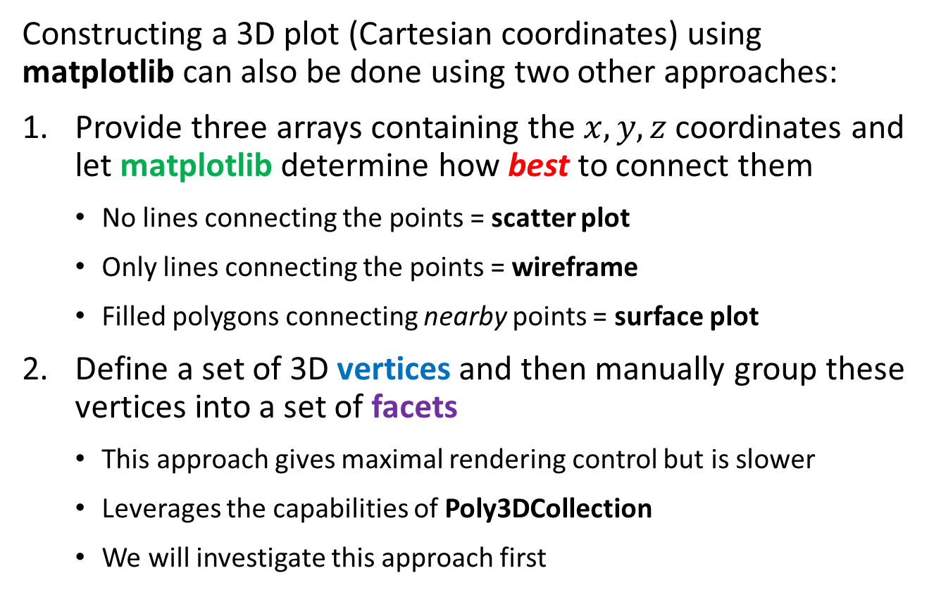
3D Axes in matplotlib
Constructing a 3D plot (Cartesian coordinates) using matplotlib can also be done using two other approaches:
Provide three arrays containing the $x, y, z$ coordinates and let matplotlib determine how best to connect them
No lines connecting the points = scatter plot
Only lines connecting the points = wireframe
Filled polygons connecting nearby points = surface plot
Define a set of 3D vertices and then manually group these vertices into a set of facets
This approach gives maximal rendering control but is slower
Leverages the capabilities of Poly3DCollection
We will investigate this approach first

Slide 9
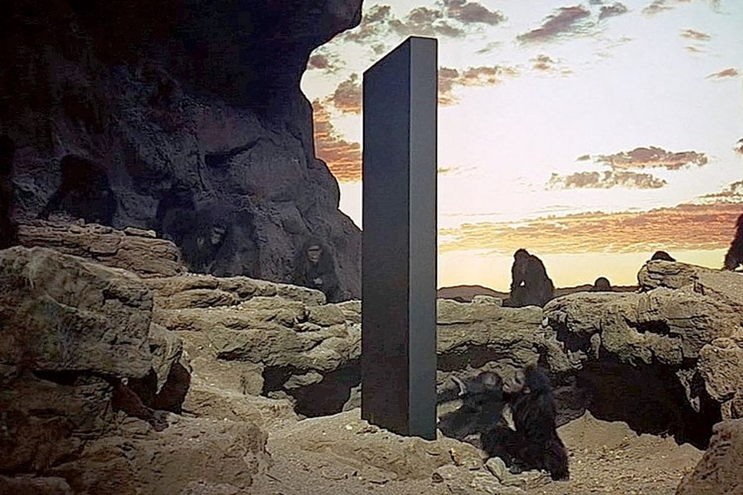
Drawing a Monolith

Slide 10
3D Cartesian Coordinates in matplotlib
$$width$$
$$length$$
$$height$$
$$height$$
$$width$$
$$length$$

Slide 11
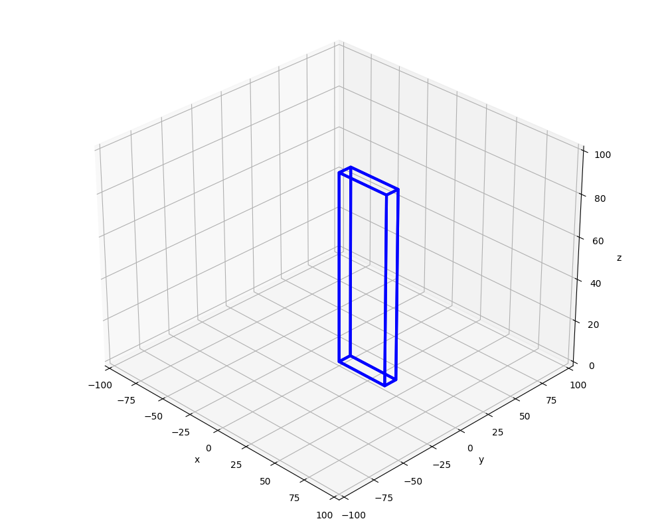
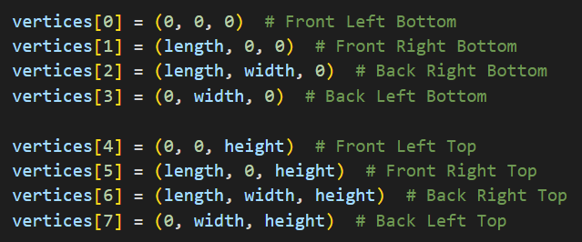
3D Cartesian Coordinates in matplotlib
⑦
④
$$length$$
⑥
⑤
$$height$$
$$length$$
③
$$width$$
⓪
②
①

Slide 12
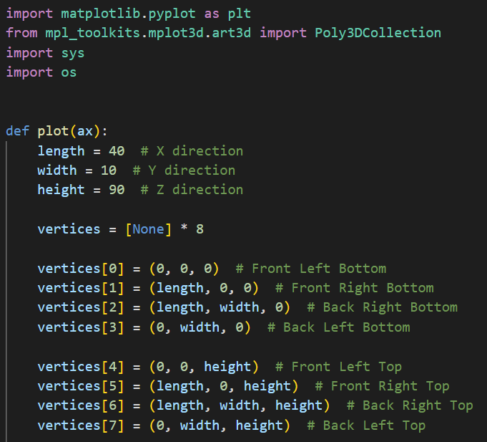
Open plot3d_monolith.py
①
②
③
④
⑤

Slide 13
3D Cartesian Coordinates in matplotlib
①
⑤
②
③
⓪
④

Slide 14
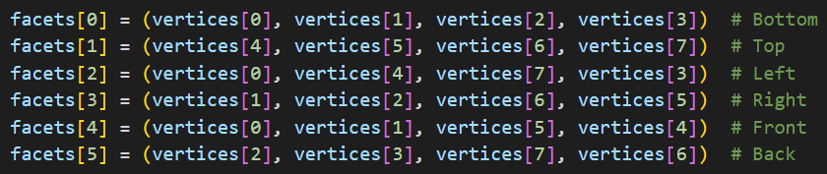
3D Cartesian Coordinates in matplotlib
⑦
④
①
⑥
⑤
⑤
②
③
③
⓪
⓪
②
④
①

Slide 15
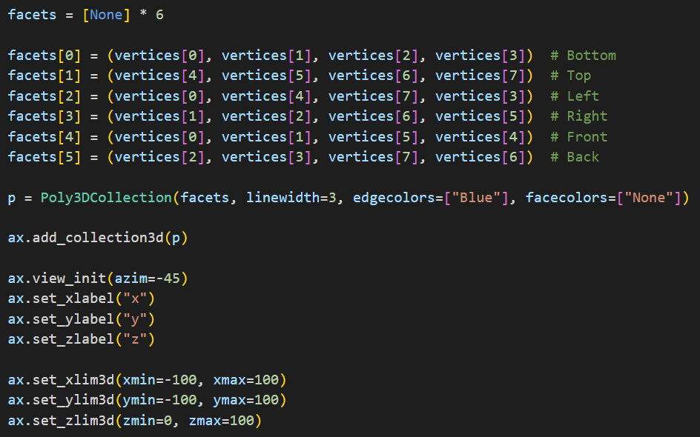
View plot3d_monolith.py
①
②
③
④
⑤
⑥
⑦
⑧

Slide 16
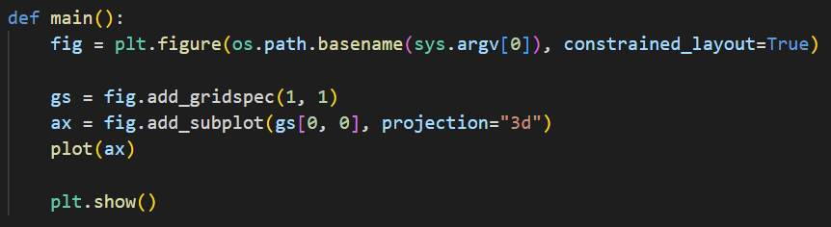
View plot3d_monolith.py
①
②

Slide 17
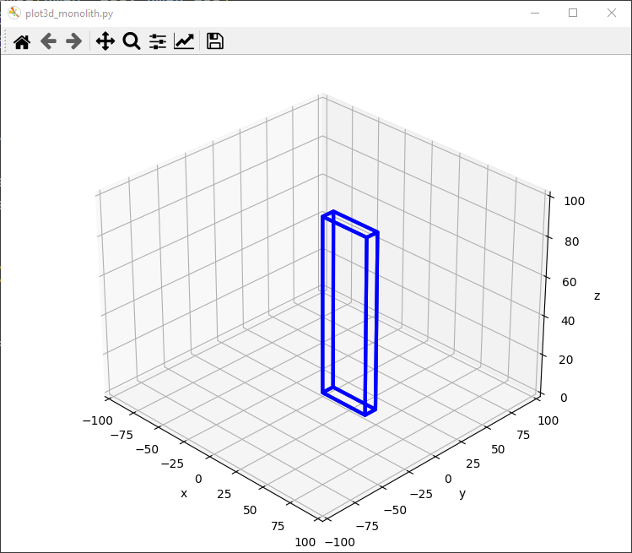
Run plot3d_monolith.py
☺

Slide 18
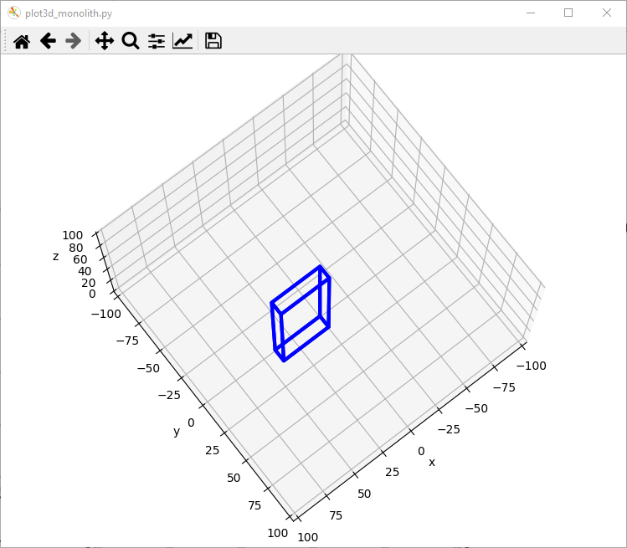
Run plot3d_monolith.py
Left click and drag to rotate the plot

Slide 19
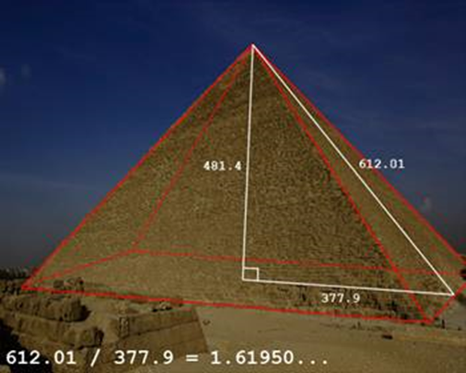
Drawing a Pyramid
Draw a pyramid with $length=width=150$ and $height=length ∗ φ$

Slide 20
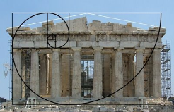

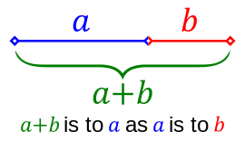
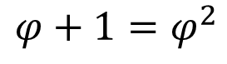
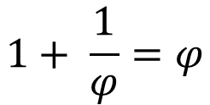
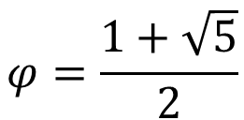
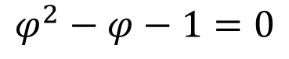
The Golden Ratio
$$1+ \frac{1}{φ}=φ$$
$$φ+1=φ^{2}$$
$$\frac{a+b}{a}=\frac{a}{b}=φ$$
$$φ^{2}−φ−1=0$$
$$1+ \frac{b}{a}=\frac{a}{b}=φ$$
$$φ=\frac{1+\sqrt{5}}{2}$$

Slide 21
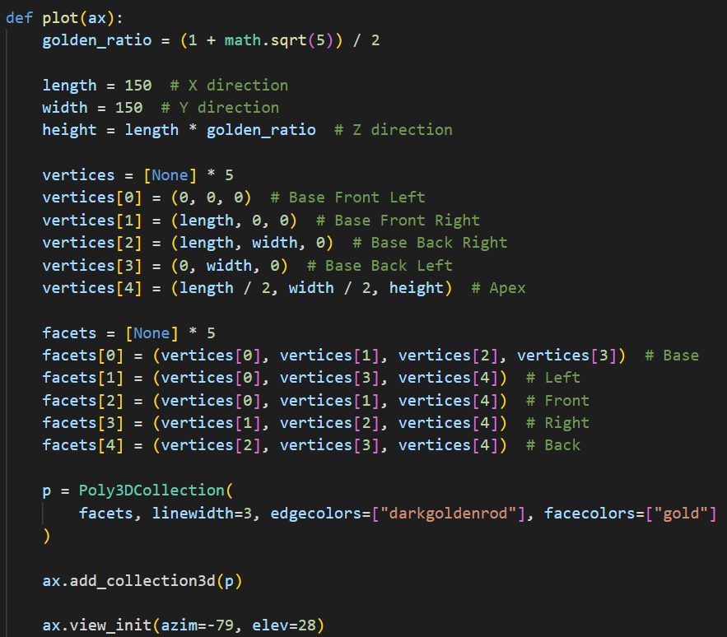
Open plot3d_pyramid.py
①
②
③
④
⑤
⑥
⑦
⑧
⑨
⑩

Slide 22
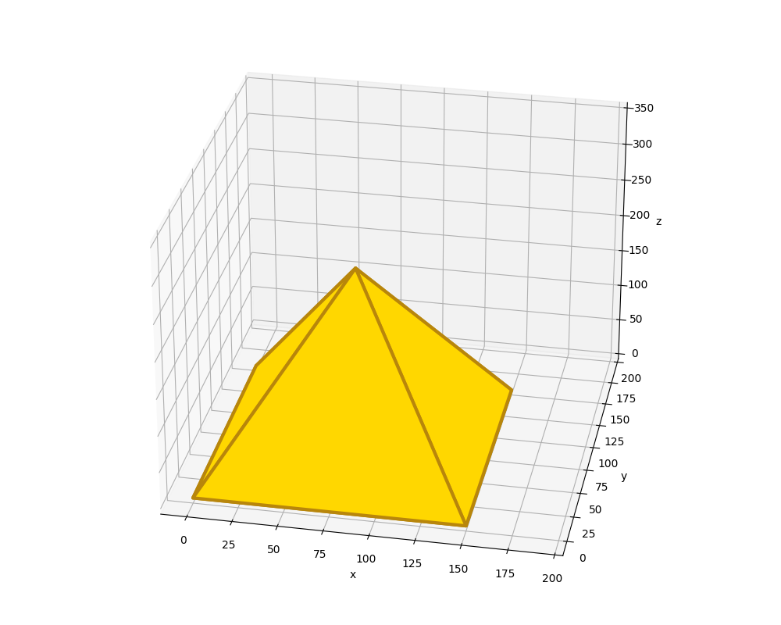
Run plot3d_pyramid.py
☺

Slide 23
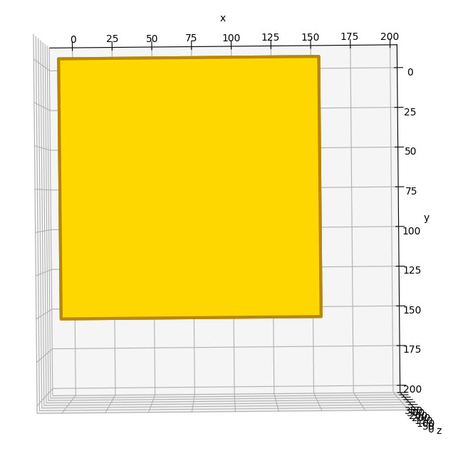
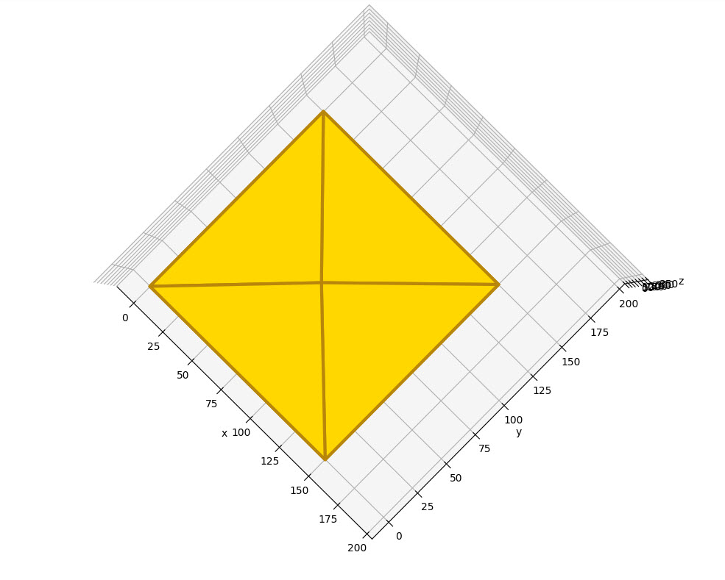
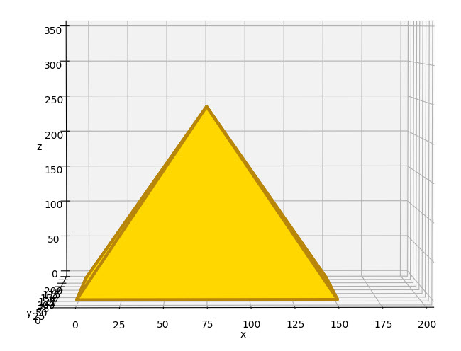
View plot3d_pyramid.py

Slide 24
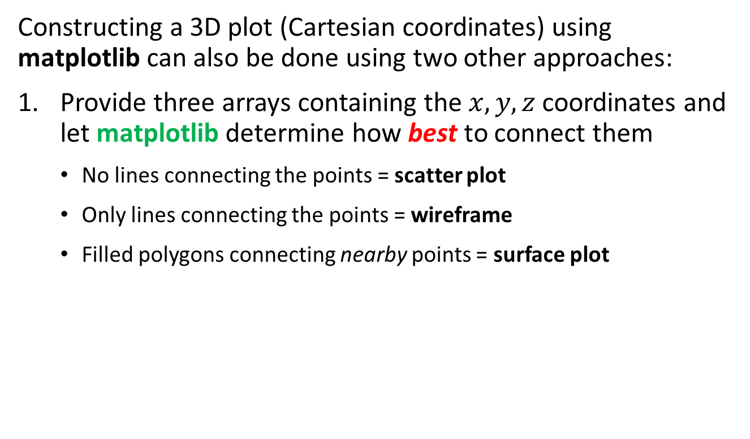
3D Axes in matplotlib
Constructing a 3D plot (Cartesian coordinates) using matplotlib can also be done using two other approaches:
Provide three arrays containing the $x, y, z$ coordinates and let matplotlib determine how best to connect them
No lines connecting the points = scatter plot
Only lines connecting the points = wireframe
Filled polygons connecting nearby points = surface plot

Slide 25
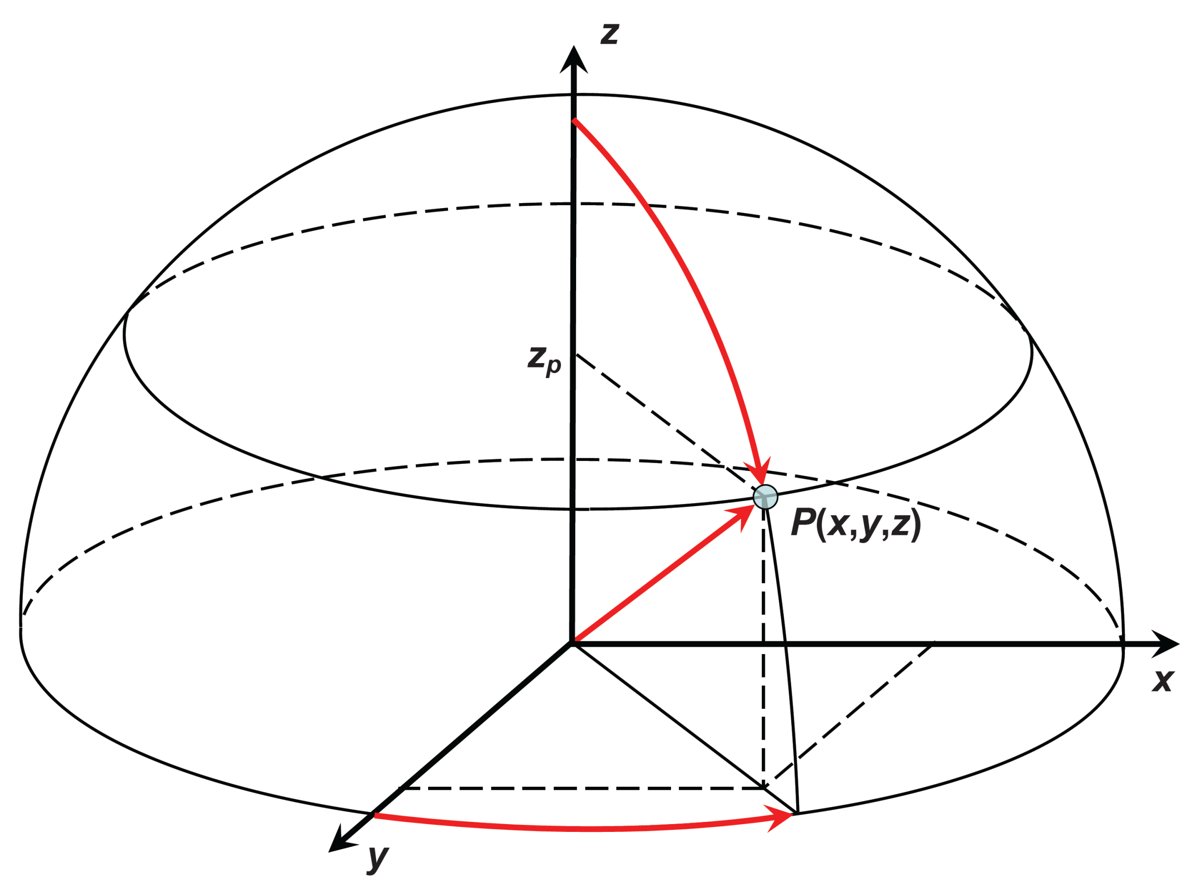

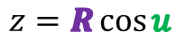
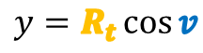
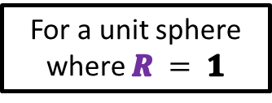

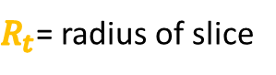
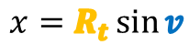
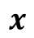
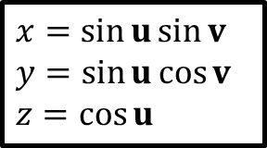

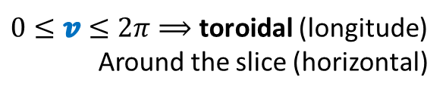
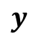
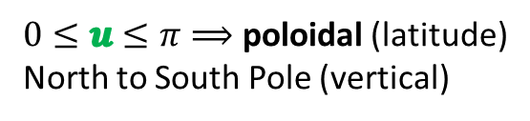
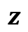

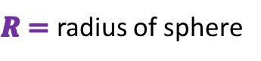


Poloidal and Toroidal Angles
$0≤u≤π⟹$ poloidal (latitude)
North to South Pole (vertical)
$0≤v≤2π⟹$ toroidal (longitude)
Around the slice (horizontal)
$R=$ radius of sphere
$R_{t}$= radius of slice
$$z=R\cos{u}$$
$$x=R_{t}\sin{v}$$
$$R_{t}=R\sin{u}$$
$$y=R_{t}\cos{v}$$
$$z$$
$$x=\sin{u}\sin{v}$$
$$y=\sin{u}\cos{v}$$
$$z=\cos{u}$$
$$R_{t}$$
$$u$$
$$R$$
$$R$$
$$x$$
$$v$$
$$R_{t}$$
For a unit sphere where $R = 1$
$$y$$

Slide 26
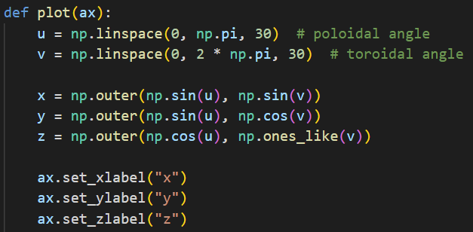
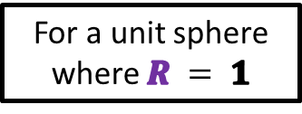
Matrices and Outer Product
$$u=(u_{1},u_{2},⋯,u_{m})$$
$$v=(v_{1},v_{2},⋯,v_{n})$$
$$x=sin{u}⨂\sin{v}$$
$$y=sin{u}⨂\cos{v}$$
$$z=\cos{u}⨂1$$
$$x=\sin{u}\sin{v}$$
$$y=\sin{u}\cos{v}$$
$$z=\cos{u}$$
$$a⨂b=\left[\begin{matrix}\begin{matrix}a_{1}b_{1} & a_{1}b_{2} \\ a_{2}b_{1} & a_{2}b_{2}\end{matrix} & ⋯ & \begin{matrix}ab_{n} \\ a_{2}b_{n}\end{matrix} \\ ⋮ & ⋱ & ⋮ \\ \begin{matrix}a_{m}b_{1} & a_{m}b_{2}\end{matrix} & ⋯ & a_{m}b_{n}\end{matrix}\right]$$
For a unit sphere where $R = 1$
Outer Product of Two Vectors

Slide 27
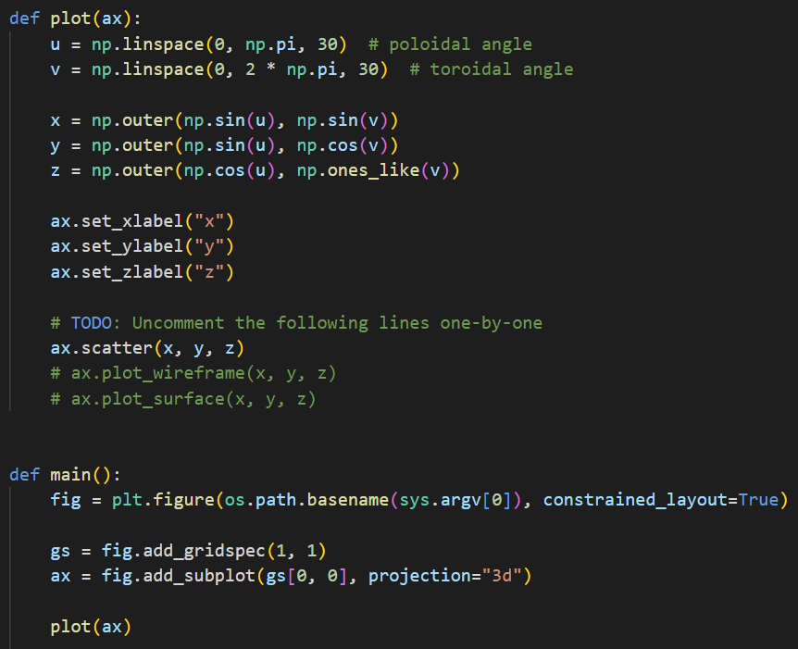
Open plot3d_sphere.py
④
⑤
⑥
⑦
⑧
⑨
①
②
③

Slide 28
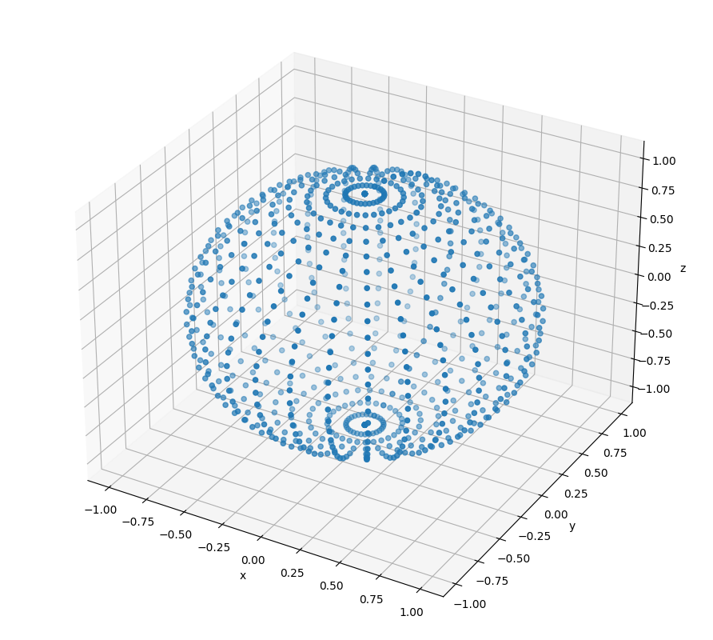
Run plot3d_sphere.py

Slide 29
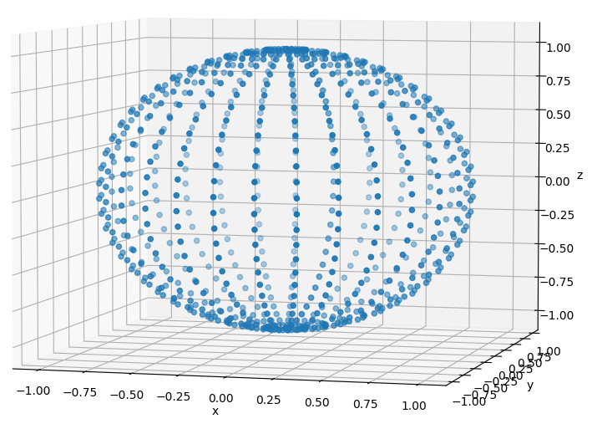
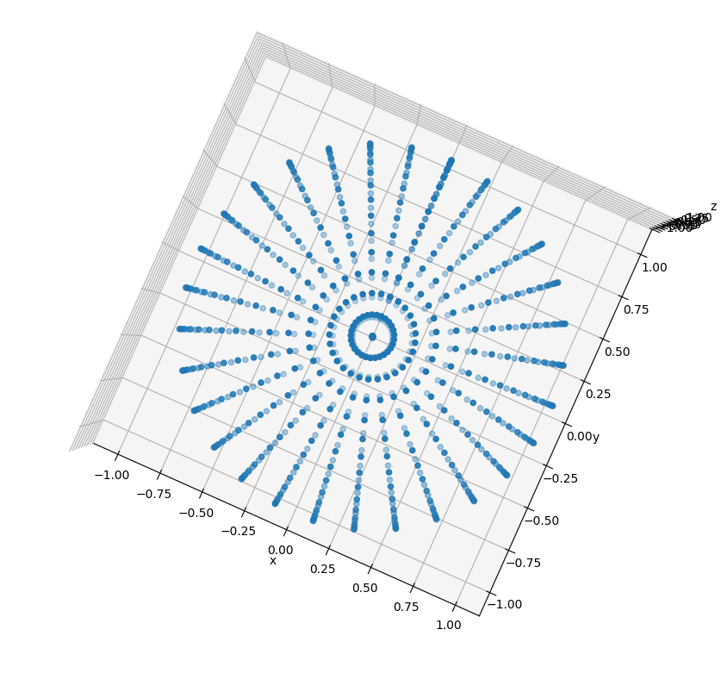
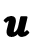
Run plot3d_sphere.py
$0≤v≤2π⟹$ toroidal (longitude)
Around the slice (horizontal)
$$u$$
$$R$$
$R_{t}$= radius of slice
$$v$$
$$R_{t}$$
$0≤u≤π⟹$ poloidal (latitude)
North to South Pole (vertical)

Slide 30
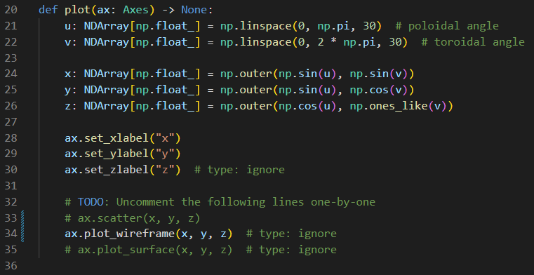
Edit plot3d_sphere.py
Comment out line 33
Uncomment line 34

Slide 31
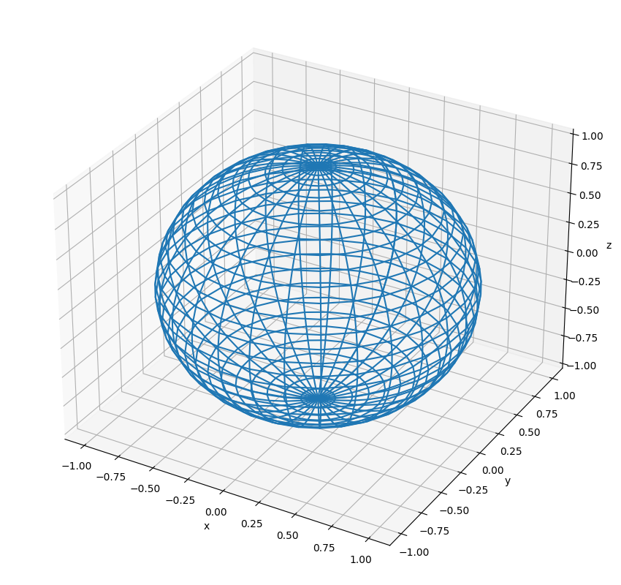
Run plot3d_sphere.py

Slide 32
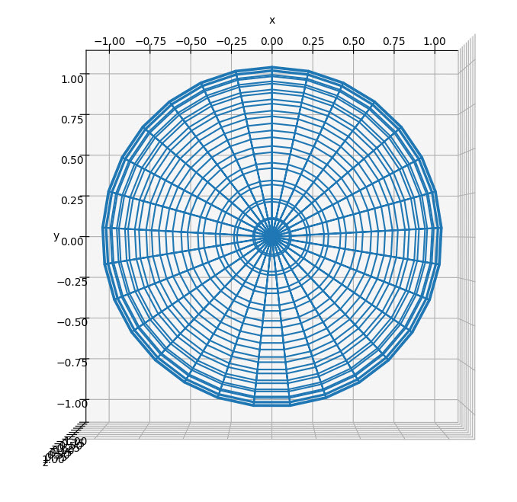
View plot3d_sphere.py
Top-Down
View

Slide 33



What is a vector?
$a_{x} a_{y} a_{z}$ are the components of
vector$\overset{⃑}{a}$
$$a_{x}={P2}_{x}−{P1}_{x}$$
$$a_{y}={P2}_{y}−{P1}_{y}$$
$$a_{z}={P2}_{z}−{P1}_{z}$$

Slide 34

What is a vector?
How do we avoid drawing the facets which are on the back of the sphere?
$$\overset{⃑}{a}$$
⓿
❶
$$\overset{⃑}{b}$$
❷

Slide 35



Vector Cross Product
The cross product of two vectors is another vector which is perpendicular to both vectors A and B

Slide 36




Every Facet has a Surface Normal Vector

Slide 37


Vector Dot Product
The dot product gives the angle between two vectors

Slide 38




Back Face Culling and Facet Shading
$$\vec{n}$$
Camera / Eye Location
$$θ$$

Slide 39

Edit plot3d_sphere.py
Comment out line 34
Uncomment line 35

Slide 40

Run plot3d_sphere.py
Left click and drag to rotate the plot

Slide 41

Run plot3d_sphere.py

Slide 42


Modelling a Torus
Your scientist would like to begin modelling the electromagnetic field around a toroidal coil carrying AC current
The first step will be defining and drawing a 3D torus using a modified version of the spherical coordinate system
The red arrow points in the poloidal direction and the blue arrow points in the toroidal direction
A sphere and a torus are not homeomorphic: unlike a sphere, a torus needs two radii to fully describe it

Slide 43






Modelling a Torus
Note: $0≤u≤2π$
$$u$$
$$(z)$$
$$R_{p}$$
$$R_{t}$$
$$x=\left[R_{t}+R_{p}\sin{u}\right]\cos{v}$$
$$y=\left[R_{t}+R_{p}\sin{u}\right]\sin{v}$$
$$z=R_{p}\cos{u}$$

Slide 44

Modelling a Torus
$$(x,y)$$
$$v$$
$$R_{t}$$
$$R_{p}$$
$$x=\left[R_{t}+R_{p}\sin{u}\right]\cos{v}$$
$$y=\left[R_{t}+R_{p}\sin{u}\right]\sin{v}$$
$$z=R_{p}\cos{u}$$

Slide 45

Open plot3d_torus.py
①
②
③
④
⑤
⑥
⑦

Slide 46

Run plot3d_torus.py

Slide 47

Edit plot3d_torus.py
Comment out line 45
Uncomment line 47

Slide 48

Run plot3d_torus.py

Slide 49


Open plot3d_surface.py
①
⑥
$$f\left(x,y\right)=\sin\left(\sqrt{x^{2}+y^{2}}\right)$$
②
③
④
NumPy Meshgrid From Zero To Hero
⑤
⑦
⑧
⑨
⑩

Slide 50



Run plot3d_surface.py
$$f\left(x,y\right)=\sin\left(\sqrt{x^{2}+y^{2}}\right)$$

Slide 51

Run plot3d_surface.py

Slide 52
Session 15 – Now You Know…
How to draw 3D images with matplotlib
How to create vertices and facets to manually build wireframe and surface plots
How to create vectors of 3D coordinates using radial angles and outer products and then letting matplotlib automatically connect nearby vertices, so it can render wireframes and surface plots
Vector algebra, including inner (dot) product and cross product, can be used to enable back-face culling and facet shading
Two shapes that are not homeomorphic may require additions to the parametric equations (inserting another radius or tracking another angular measure) such as drawing a torus vs. a sphere

Slide 53


Task 15-01
Create a Python file called plot3d_cylinder.py that uses matplotlib to draw a wireframe cylinder with a unit radius centered at $(0, 0, 0)$
The cylinder should be aligned along the z-axis
Upload your solution to the BNL QIS101 SharePoint site

Slide 54


Task 15-02
Create a Python file called plot3d_complex_sine.py that uses matplotlib to draw the surface in $ℂ$ given by $f\left(z\right)=\left|\sin\left(z\right)\right|$ over the region $\left(±2.5±i\right)$
Upload your solution to the BNL QIS101 SharePoint site

